Slide 1

M5 Forecasting - Accuracy
TOM Talk
Estimating the Unit Sales of Walmart retail goods
Thomas Pin – UBC Master of Data Science Recent Graduate
LinkedIn: https://www.linkedin.com/in/thomaspin/
September 17, 2020

Slide 2
M5 Forecasting - Accuracy
TOM Talk
Matt Emery
Estimating the Unit Sales of Walmart retail goods
Thomas Pin – UBC Master of Data Science Recent Graduate
LinkedIn: https://www.linkedin.com/in/thomaspin/
September 17, 2020

Slide 3
Introduction

Slide 4
Spyros Makridakis
Professor at the University of Nicosia (Cyprus)
20 Publish Articles:
Forecasting methods and applications
Forecasting and planning: an evaluation
Averages of forecasts: some empirical results
Accuracy of forecasting: an empirical investigation
Dubbed one of the Fathers of Forecasting
Source: Spyros Makridakis, https://twitter.com/spyrosmakrid/photo

Slide 5


Slide 6
Makridakis Competitions or M Competitions
Competition Name | Year | Number of Time Series Used
M competition | 1982 | 1,001
M2 competition | 1993 | 29 (real time)
M3 competition | 2000 | 3,003
M4 competition | 2018 | 100,000
M5 competition | 2020 | 10,000 (hierarchical timeseries)
Notes:
https://en.wikipedia.org/wiki/Makridakis_Competitions
The Makridakis Competitions (also known as the M Competitions or M-Competitions) are a series of open competitions organized by teams led by forecasting researcher Spyros Makridakis and intended to evaluate and compare the accuracy of different forecasting methods.

Slide 7

Makridakis Competitions or M Competitions
Competition Name | Year | Number of Time Series Used
M competition | 1982 | 1,001
M2 competition | 1993 | 29 (real time)
M3 competition | 2000 | 3,003
M4 competition | 2018 | 100,000
M5 competition | 2020 | 10,000 (hierarchical timeseries)
Slawek Smyl

Slide 8
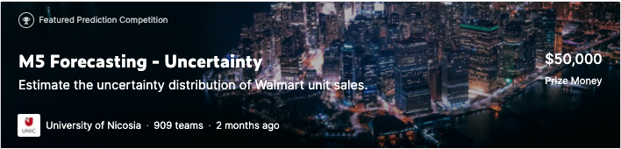
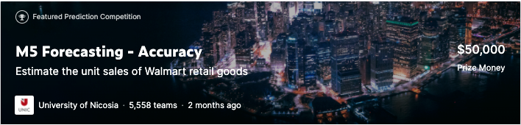
M5 Competition

Slide 9
M5 Competition

Slide 10
Overview

Slide 11
M5 Forecasting Accuracy – Overview
Price Pool - $50,000
42,840 time series
Walmart Hierarchical Sales Data
Days (1 – 1941) '2011-01-29’ to '2016-06-19’
A Walmart Inc. store in Secaucus, New Jersey. Photographer: Timothy Fadek/Bloomberg

Slide 12
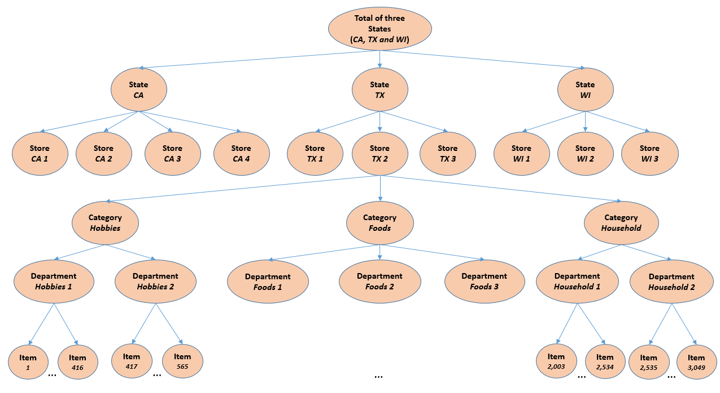
M5 Forecasting Accuracy – Data Hierarchy
Source: M5 Competitors Guide Final 10 March 2020 Link

Slide 13

M5 Forecasting Accuracy – Data Files
calendar.csv
sell_prices.csv
sample_submission.csv
sales_train_validation.csv

Slide 14
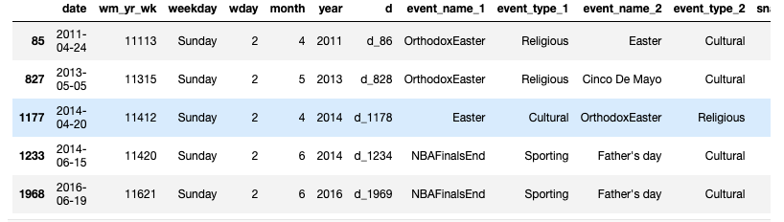
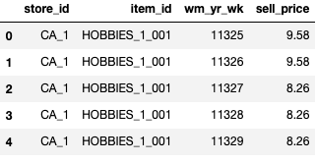
M5 Forecasting Accuracy – Data Files
calendar.csv
sell_prices.csv

Slide 15
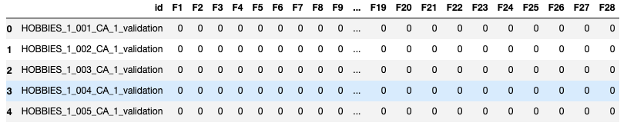
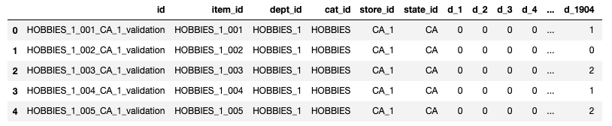
M5 Forecasting Accuracy – Data Files
sample_submission.csv
sales_train_validation.csv

Slide 16
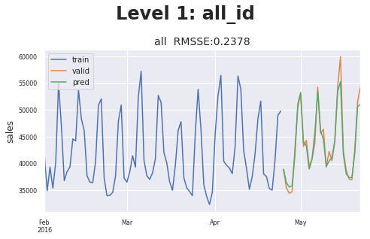
M5 Forecasting Accuracy – Scoring
Objective – Forecast Daily Sales for the next 28 days (4 weeks ahead) for each of 42,840 units
28 days ahead point forecasts (PFs)
Source: @Matthias - Solution

Slide 17
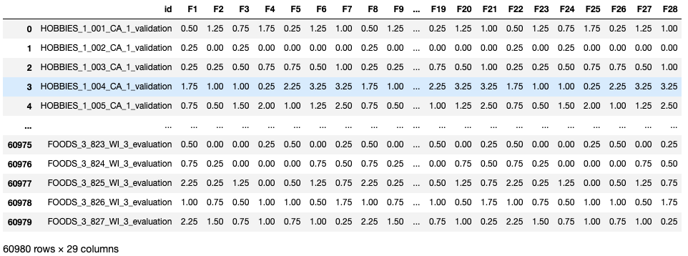
M5 Forecasting Accuracy – Scoring
Objective – Forecast Daily Sales for the next 28 days (4 weeks ahead)
28 days ahead point forecasts (PFs)
Notes:
More context: https://www.kaggle.com/c/m5-forecasting-accuracy/discussion/133498

Slide 18
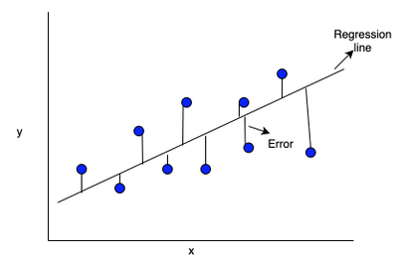
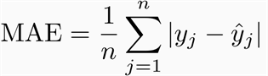
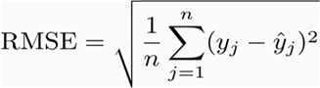
Quick A Side – Scoring Error
Mean Absolute Error (MAE)
Root mean squared error (RMSE)
Source: Error
Notes:
https://medium.com/@agrimabahl/mape-v-s-mae-v-s-rmse-3e358fd58f65

Slide 19
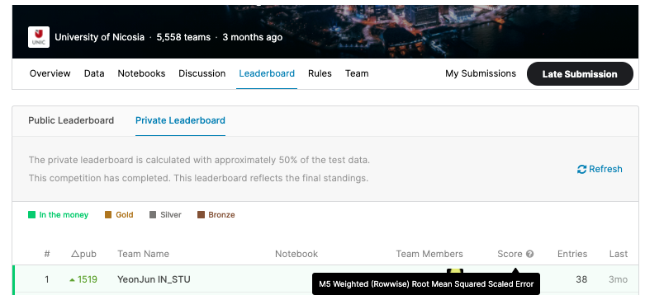
M5 Forecasting Accuracy – Scoring
Source: M5 Leader Boards
Notes:
https://www.kaggle.com/c/m5-forecasting-accuracy/leaderboard

Slide 20
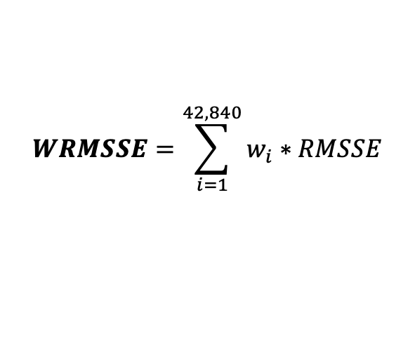
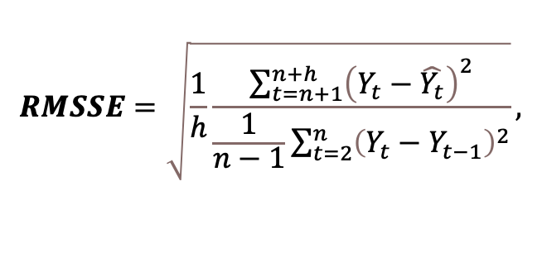
M5 Forecasting Accuracy – Scoring
Point Forecasts - Root Mean Squared Scaled Error (RMSSE)
After estimating all 42,840 RMSSEs
Ranking – Weighted RMSSE (WRMSSE)
$$RMSSE=\sqrt{\frac{1}{h}\frac{\sum_{t=n+1}^{n+h}{{\left(Y_{t}−\hat{Y_{t}}\right)}^{2}}}{\frac{1}{n−1}\sum_{t=2}^{n}{{\left(Y_{t}−Y_{t−1}\right)}^{2}}}},$$
$$WRMSSE=\sum_{i=1}^{42,840}{w_{i}∗RMSSE}$$
Notes:
Why RMSSE?
The scaling was introduced to provide a scale-free error regardless of the data. An example for this competition would be a product that sells hundreds of units per day vs. a product that only sells a few times a week or month (the intermittent demand we are seeing in there series).
Keeping that in mind our measurement is now scale free which allows us to compare many different types of time series. Another reason we are using RMSSE is because it does not suffer from actual values $Y_t$ being zero like the MAPE metric.

Slide 21
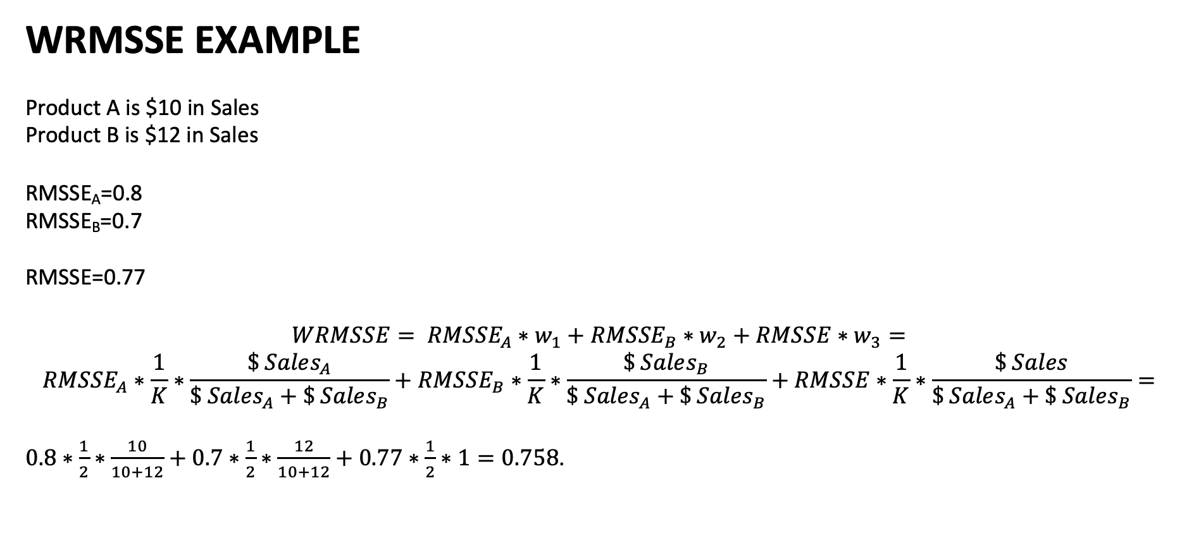
M5 Forecasting Accuracy – Scoring Reasoning
WRMSSE EXAMPLE
Product A is $10 in Sales
Product B is $12 in Sales
RMSSE_{A}=0.8
RMSSE_{B}=0.7
RMSSE=0.77
$${WRMSSE= RMSSE}_{A}∗w_{1}+{RMSSE}_{B}∗w_{2}+RMSSE∗w_{3}=$$
$$RMSSE_{A}∗\frac{1}{K}∗\frac{\$ Sales_{A}}{\$ Sales_{A}+\$ Sales_{B}}+RMSSE_{B}∗\frac{1}{K}∗\frac{\$ Sales_{B}}{\$ Sales_{A}+\$ Sales_{B}}+RMSSE∗\frac{1}{K}∗\frac{\$ Sales}{\$ Sales_{A}+\$ Sales_{B}}=$$
$0.8∗\frac{1}{2}∗\frac{10}{10+12}+0.7∗\frac{1}{2}∗\frac{12}{10+12}+0.77∗\frac{1}{2}∗1=0.758$.
Notes:
Why RMSSE?
The scaling was introduced to provide a scale-free error regardless of the data. An example for this competition would be a product that sells hundreds of units per day vs. a product that only sells a few times a week or month (the intermittent demand we are seeing in there series).
Keeping that in mind our measurement is now scale free which allows us to compare many different types of time series. Another reason we are using RMSSE is because it does not suffer from actual values $Y_t$ being zero like the MAPE metric.

Slide 22
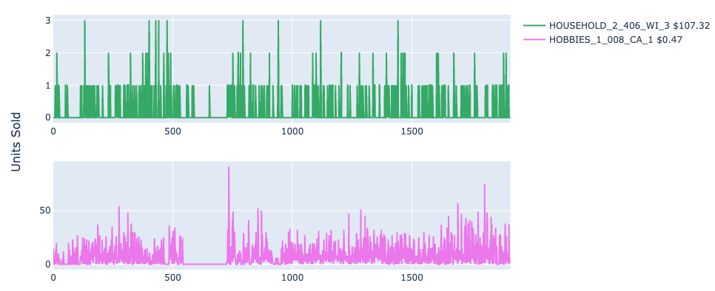
M5 Forecasting Accuracy – Scoring Reasoning
High price low volume &
Low Price high volume

Slide 23
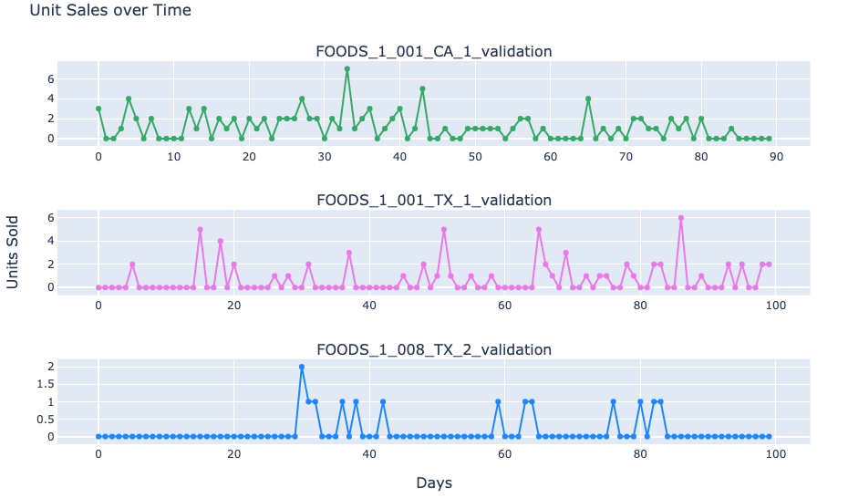
M5 Forecasting Accuracy – EDA

Slide 24
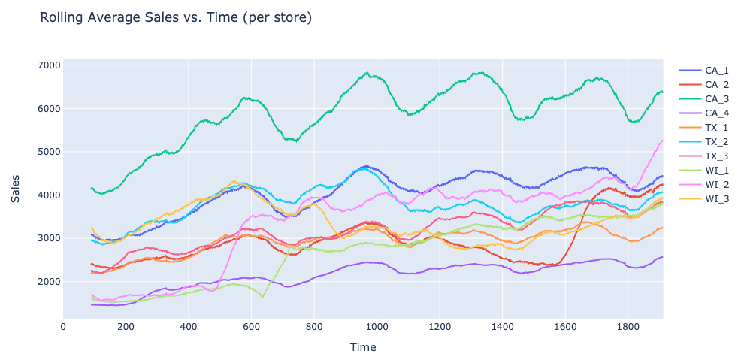
M5 Forecasting Accuracy – EDA

Slide 25
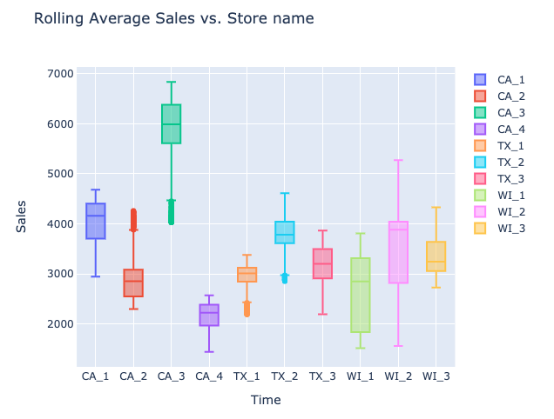
M5 Forecasting Accuracy – EDA

Slide 26







M5 Forecasting Accuracy – Challenges
Comparing different states,
stores, categories and departments
Weather and Disaster
Out of Stock
Anomaly – Blue Moon Event
Notes:
Maybe drop this one

Slide 27
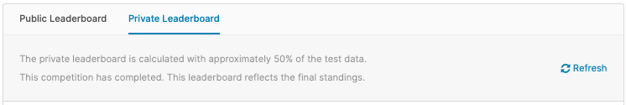
Quick A Side – Leaderboards
Public Leader board d_1914 - d_1941
Release May 31st, 2020
Private Leader board d_1942 - d_1969
Released June 30th, 2020 (Deadline June 23rd, 2020)
Notes:
Maybe drop this one

Slide 28
Solution Techniques

Slide 29
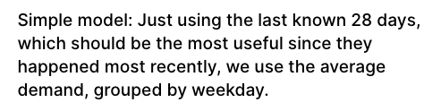
M5 Forecasting Accuracy – Baseline Score
Kaggle: @chrisrichardmiles

Slide 30

M5 Forecasting Accuracy – Rational
July 20XX
Sunday
Monday
Tuesday
Wednesday
Thursday
Friday
Sunday
120X
10X
30X
30X
100X
60X
240X

Slide 31
M5 Forecasting Accuracy – Baseline Score
Kaggle: @chrisrichardmiles
PUBLIC SCORE: 0.75238

Slide 32
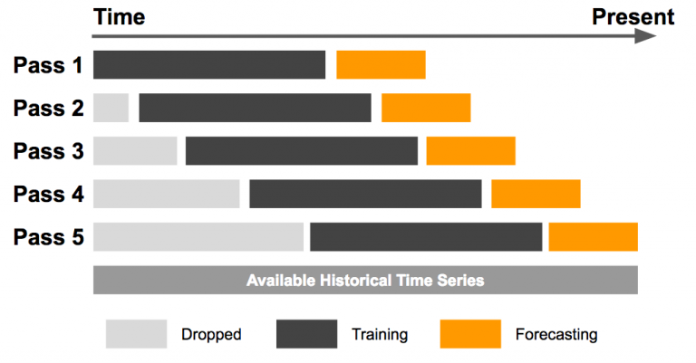
Solution Technique – Sliding Window
Source: Roy Yang Omphalos, Uber’s Parallel and Language-Extensible Time Series Backtesting Tool January 24, 2018 link
Notes:
Figure 1: In the sliding window back testing model, a fixed-size training window (in black) slides over the entire history of a time series and is repeatedly tested against a forecasting window (in orange) with older data points dropped.

Slide 33
Solution Technique – @YeonJun IN 1st Place Solution
CV1 d_1830 - d_1857
CV2 d_1858 - d_1885
CV3 d_1886 - d_1913
*Each CV is 28 Days Long*
Source: Roy Yang Omphalos, Uber’s Parallel and Language-Extensible Time Series Backtesting Tool January 24, 2018 link
Notes:
Cv1: 2016-02-01 - 2016-02-28 Cv2: 2016-02-29 - 2016-03-27
Cv3: 2016-03-28 - 2016-04-24

Slide 34
Solution Technique – @YeonJun IN 1st Place Solution
Public d_1914 - d_1941
Private d_1942 - d_1969
Source: Roy Yang Omphalos, Uber’s Parallel and Language-Extensible Time Series Backtesting Tool January 24, 2018 link
Notes:
Cv1: 2016-02-01 - 2016-02-28 Cv2: 2016-02-29 - 2016-03-27
Cv3: 2016-03-28 - 2016-04-24

Slide 35
Quick A Side – Recursion
Source: Shmuel Lotman Link
Notes:
Figure 1: In the sliding window back testing model, a fixed-size training window (in black) slides over the entire history of a time series and is repeatedly tested against a forecasting window (in orange) with older data points dropped.

Slide 36
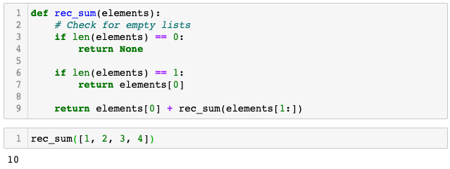
Quick A Side – Recursion Simple Example

Slide 37
Solution Technique – Direct vs. Recursive Method
1. Direct Multi-step Forecast Strategy
2. Recursive Multi-step Forecast
3. Direct-Recursive Hybrid Strategies
Source: Jason Brownlee, 4 Strategies for Multi-Step Time Series Forecasting, March 9, 2017 Link

Slide 38
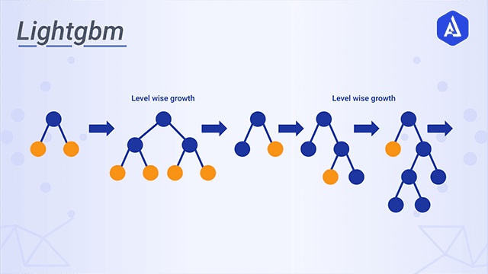
Solution Technique – LightGBM
Source: Akira AI, Lightgbm
Notes:
Resource 1
https://www.avanwyk.com/an-overview-of-lightgbm/#:~:text=LightGBM%20is%20an%20open%2Dsource,%2DSide%20Sampling%20(Goss).
Resource 2
https://www.gormanalysis.com/blog/gradient-boosting-explained/

Slide 39
Solution Technique – LightGBM
Training speed faster without compromising efficiency
The memory usage is also low
It provides better accuracy
It supports two types of learning parallel and GPU
It has the capability of handling large scale data
Source: Akira AI, Lightgbm
Notes:
Resource 1
https://www.avanwyk.com/an-overview-of-lightgbm/#:~:text=LightGBM%20is%20an%20open%2Dsource,%2DSide%20Sampling%20(Goss).
Resource 2
https://www.gormanalysis.com/blog/gradient-boosting-explained/

Slide 40
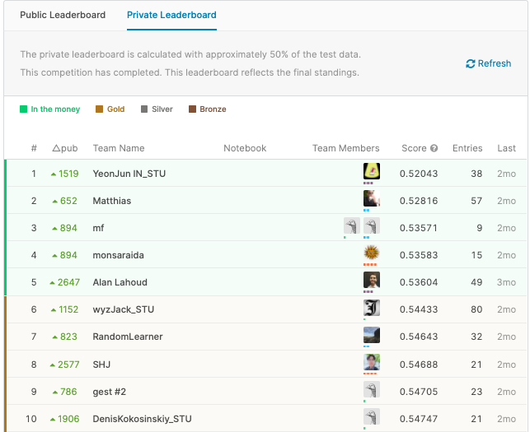
Results – Models
No Public Solution
LightGBM
DeepAR

Slide 41
Why LGBM?

Slide 42
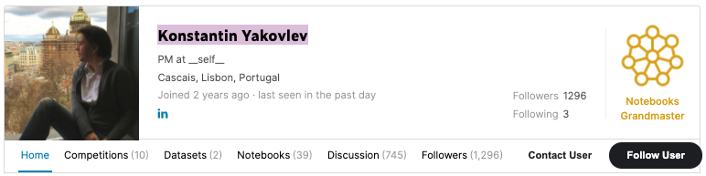
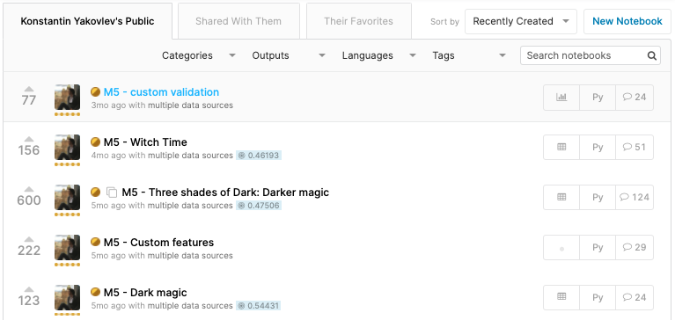
Solution Technique – LightGBM
Kaggle: @kyakovlev
Notes:
Konstantin Yakovlev

Slide 43
Solution Technique – LightGBM
PUBLIC SCORE: 0.47506
Kaggle: @kyakovlev

Slide 44
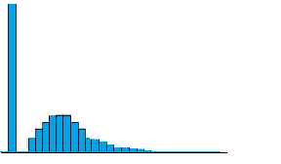
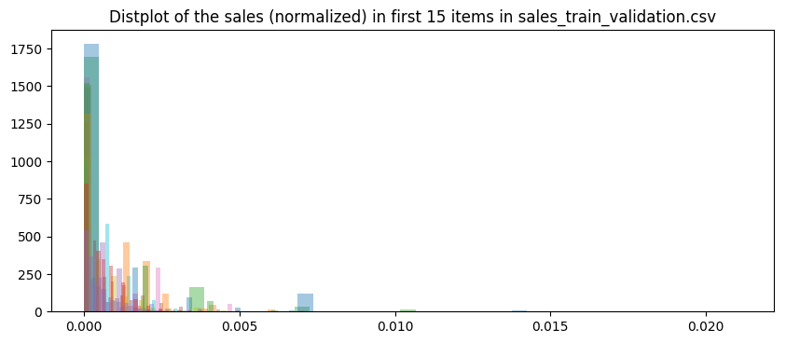
Solution Technique – Objection: Tweedie
Source: tweedie-distribution
Source: distplot of the sales
Source: Why tweedie works? @timetraveller
Notes:
It is a type exponental dispersion model (ED). ED is a very general type of probability distribution models where the PDF (probab. distribution function) is represented using exponents. A very common example would be the normal distrbution whose PDF is well known (and exponential).
It has a special relation between mean and variance. i.e. the variance ~ some power of mean (Variance=k*Mean^p). This constant, "p" is important and is the tweedie_variance_power parameter in the lightgbm's API (default value 1.5).
The well known poisson (p=1) and gamma (p=2) distributions can be considered special cases of tweedie. (Now we know why the kernels using poisson regression works better than L2 regression and tweedie works even better)
The distribution is not defined for p>2 and p<1

Slide 45
Results/Solutions

Slide 46
Results – Leaderboard

Slide 47
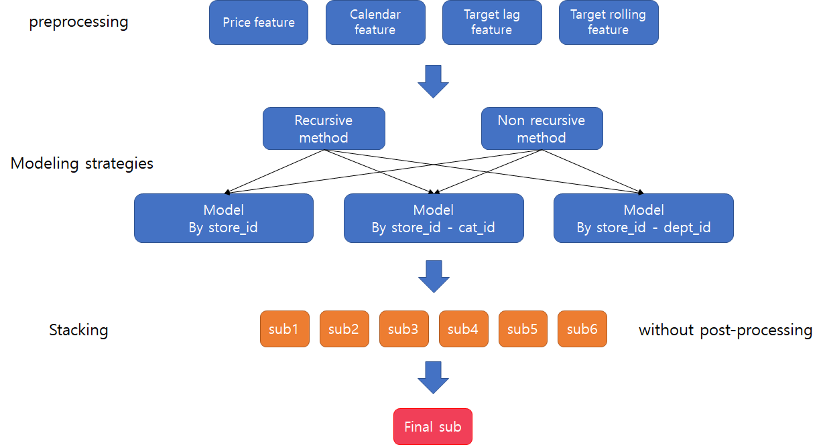
Solution – @YeonJun IN 1st Place Solution
Source: @YeonJun In - Solution

Slide 48
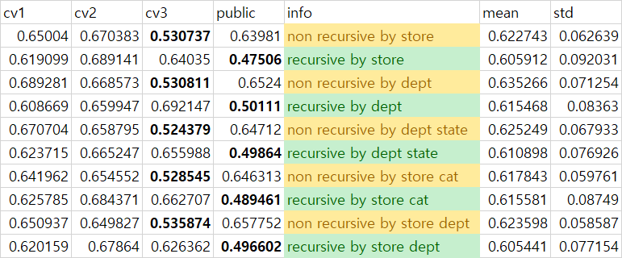
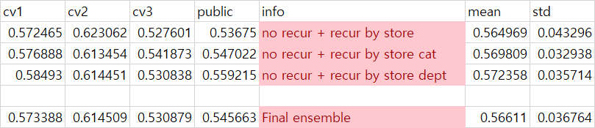
Solution – @YeonJun IN 1st Place Solution
Source: @YeonJun In - CVs Results

Slide 49
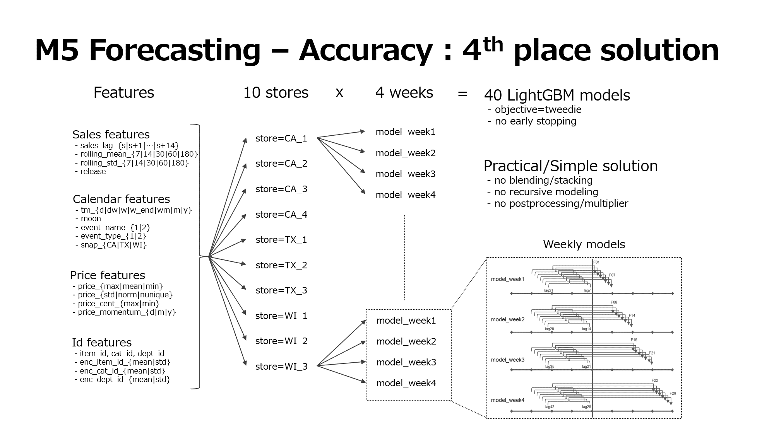
Solution – @monsaraida IN 4th Place Solution
Source: @monsaraida - Solution

Slide 51
Title
Text

